Slide 1
EE 570: Location and Navigation: Theory & Practice
The Global Positioning System (GPS)

Slide 2
The Global Positioning System (GPS) Dead Reckoning vs Position Fixing
Navigation can be accomplished via “position fixing” or “dead reckoning”
Dead Reckoning - Measures changes in position and/or attitude
Inertial sensors provide relative position (and attitude)
Position Fixing - Directly measuring location
GPS provides absolute position (and velocity)
How does GPS work?
Effectively via Multilateration
If I can measure my distance to three (or more) satellites at known locations, then, own location can be resolved
Measure distance via “time-of-flight” (speed of light)

Slide 3
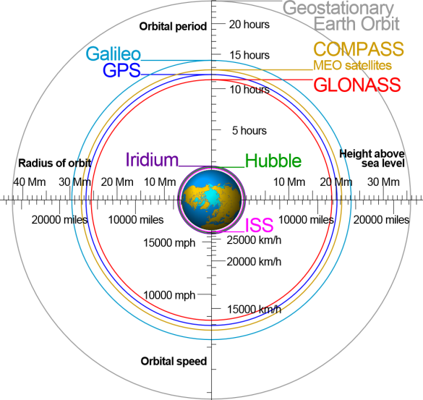
The Global Positioning System (GPS) An Overview
The GPS is a Space-Based Global Navigation Satellite System (GNSS)
Space segment (satellites)
First satellites launched in 1989
Control segment (ground station(s))
Master control segment, alternate, and monitors
User segment (receivers)
Both military and civilian
Other GPS-like systems exist
GLONASS – Russian
COMPASS/BeiDou – China
Galileo - European Union (EU)
wikipedia

Slide 4
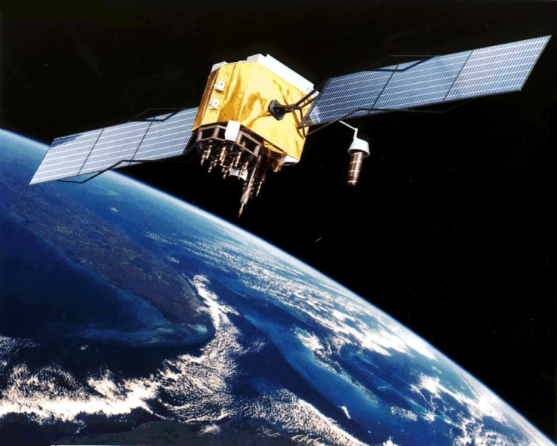
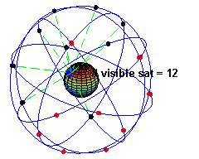
The Global Positioning System (GPS) Overview – The Space Segment
The Space Segment
A constellation of 24 satellites in 6 orbital planes
Four satellites in each plane
20,200 km altitude at 55° inclination
Each satellite’s orbital period is ~12 hours
>6 satellites visible in each hemisphere
Courtesy of MATLAB™

Slide 5
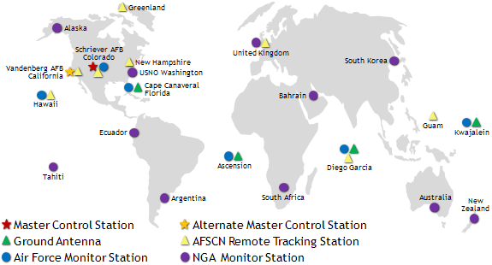
The Global Positioning System (GPS) Overview – The Control segment
The Control segment
Tracking stations around the world
1 Master control station
Command & Control
1 Alternate control station
Backup
16 Monitor stations
Orbit monitoring
4 dedicated ground antenna
Communication
gps.gov

Slide 6
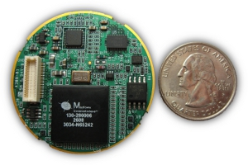
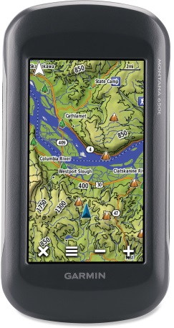
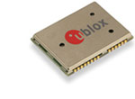
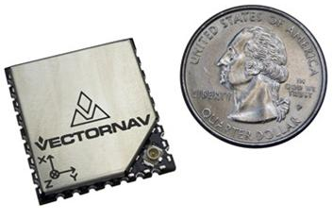
The Global Positioning System (GPS) Overview – The User Segment
The User Segment
Military receivers can receive encrypted GPS signals to realize higher performance
E.g. Selectively Available Anti-Spoofing Module (SAASM ) and Precise Positioning System (PPS) encrypted key based systems
Civilian receivers
Commercial handheld
e.g. Gamrin Montana 650
OEM chipsets
ublox
Multi-GNSS engine for GPS, GLONASS, Galileo and QZSS
Vectornav
VN-200 OEM GPS-Aided Inertial Navigation System
NavAssure® 100

Slide 7
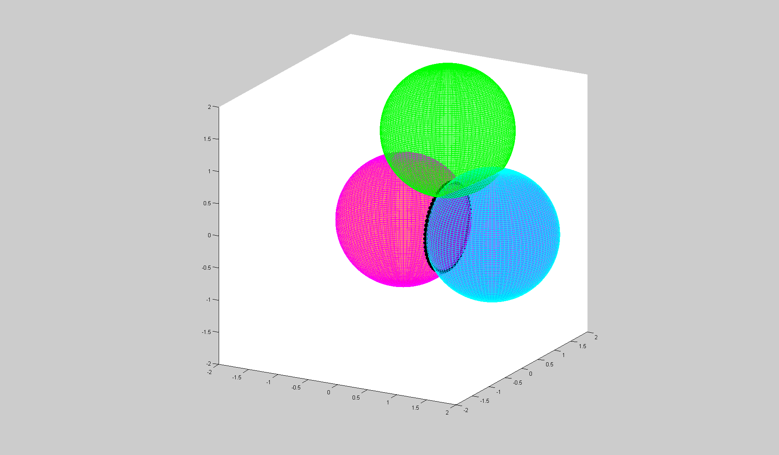
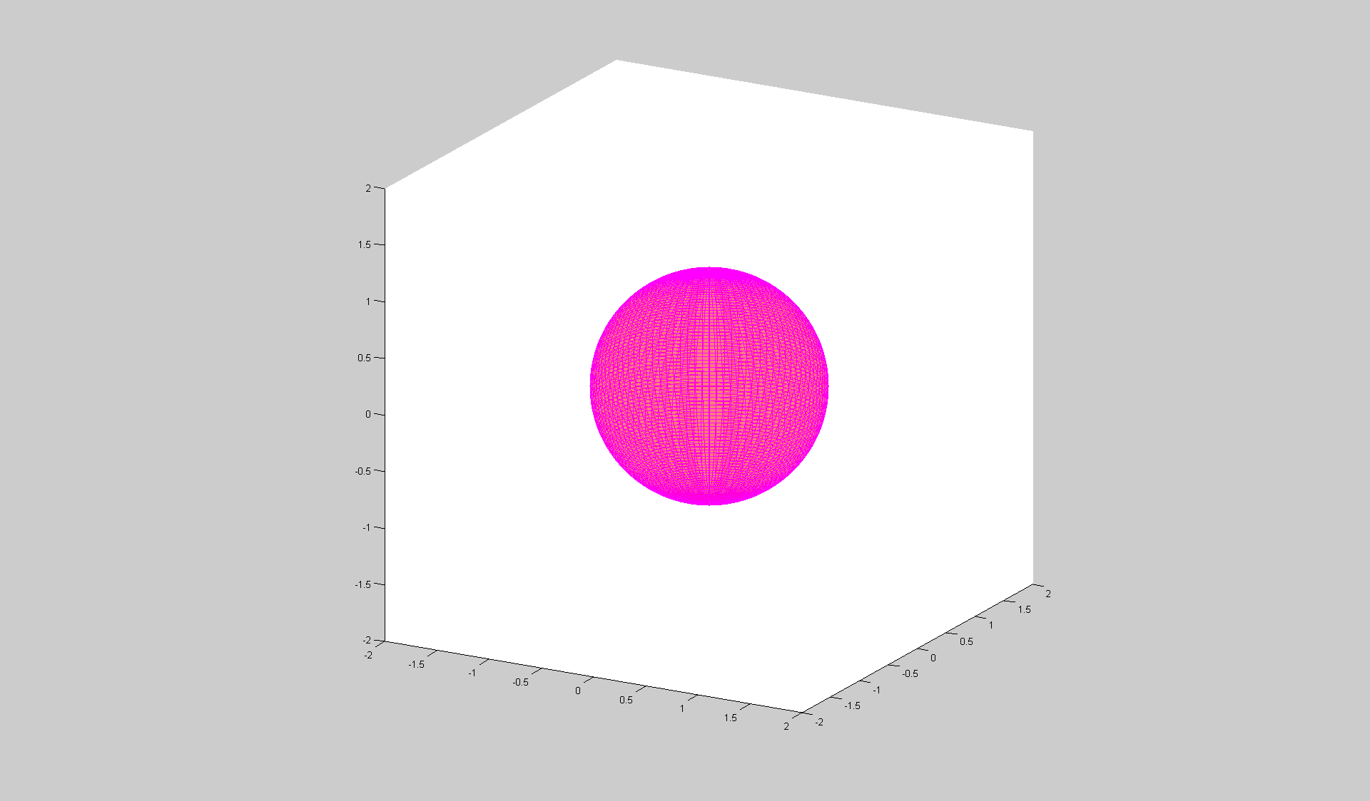
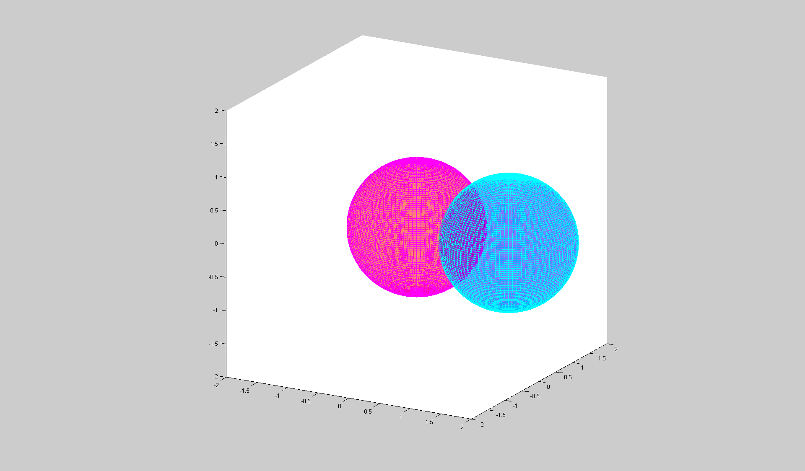
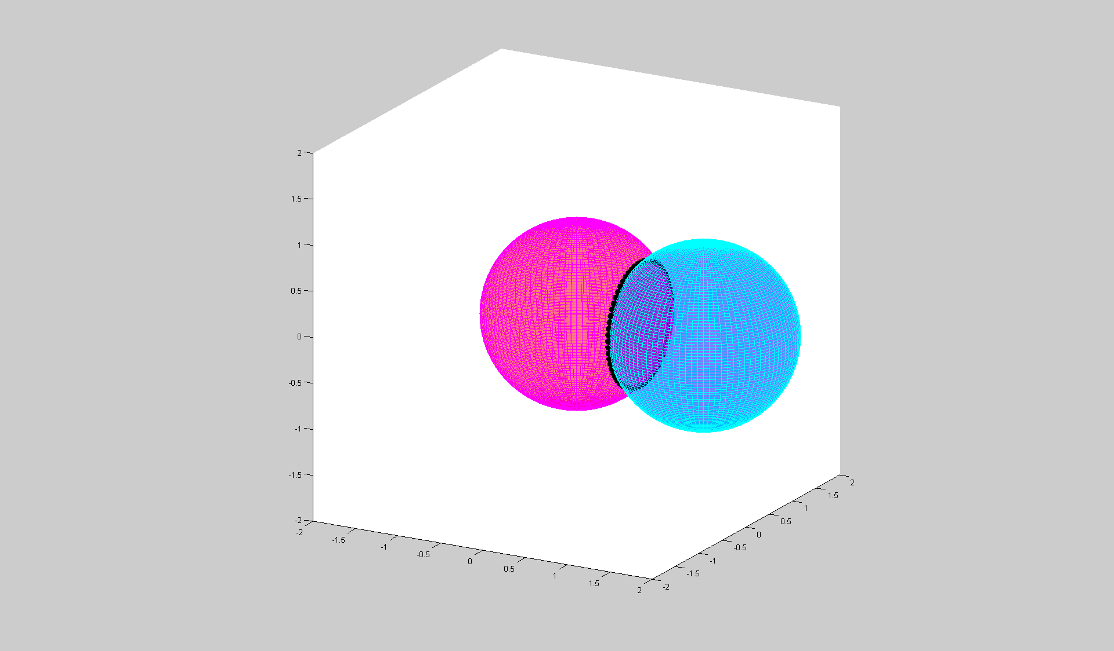
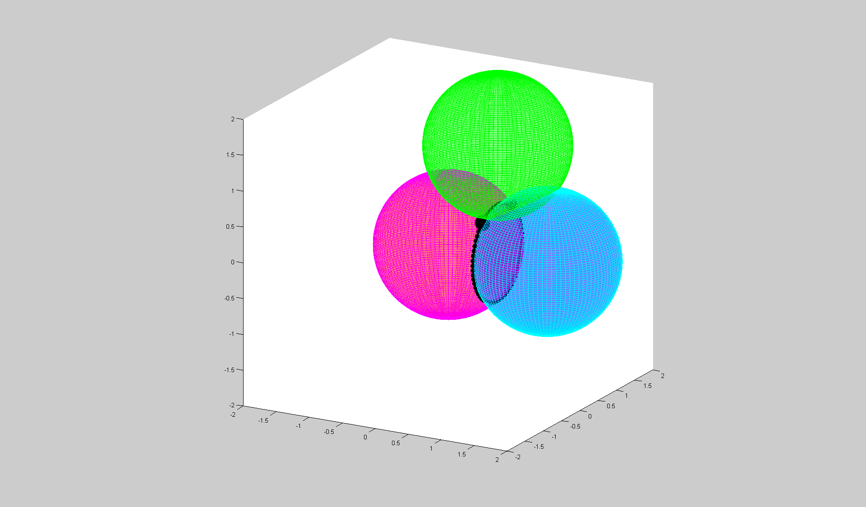
The Global Positioning System (GPS) Multilateration - Intersection of Spheres
1 satellite – A sphere
3 satellites – Two points
2 satellites – A circle

Slide 8
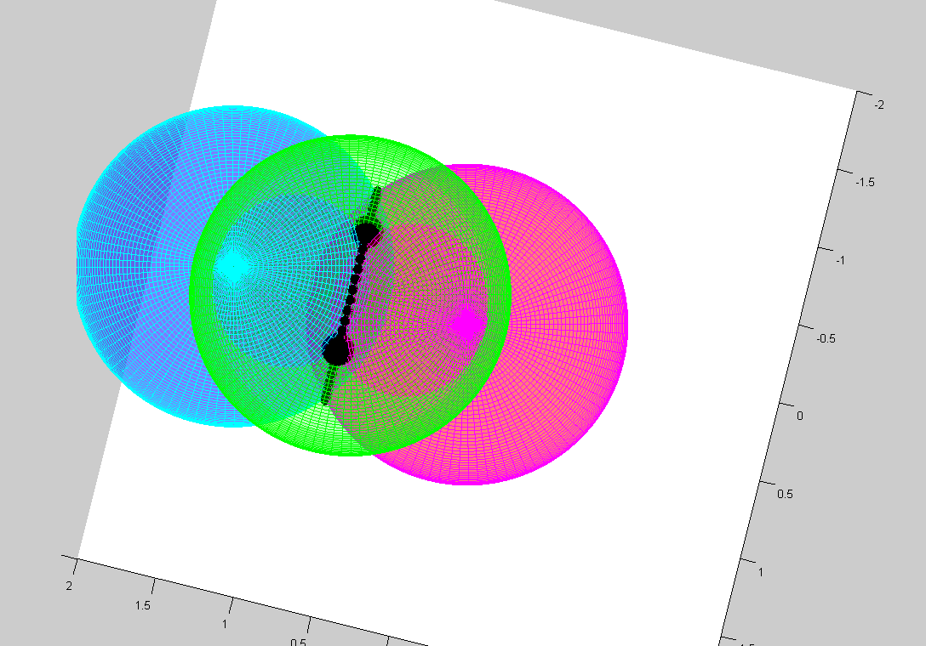
The Global Positioning System (GPS) Multilateration - Intersection of Spheres
Only one of the two points will be feasible
E.g. on the surface of the Earth
3 satellites – Two points

Slide 9
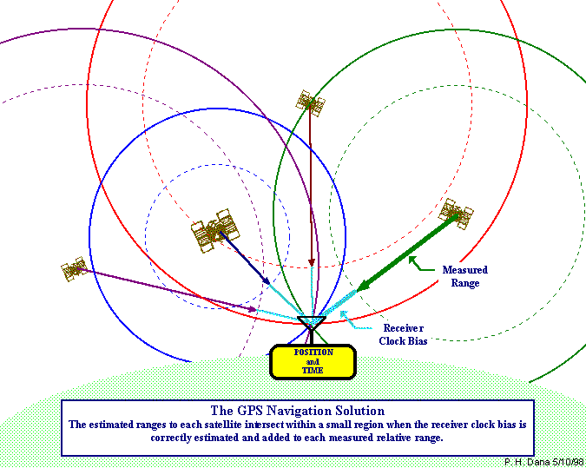
The Global Positioning System (GPS) Multilateration – Basic Idea
Multilateration – The Basic Idea
Determine range to a given satellite via time-of-flight of an RF signal (i.e. speed of light)
Requires very precise time bases
Receiver clock bias

Slide 10
The Global Positioning System (GPS) Modulation Scheme
Position is determined by the travel time of a signal from four or more satellites to the receiving antenna
Three satellites for X, Y, Z position, one satellite to solve for clock biases in the receiver
Image Source: NASA

Slide 11
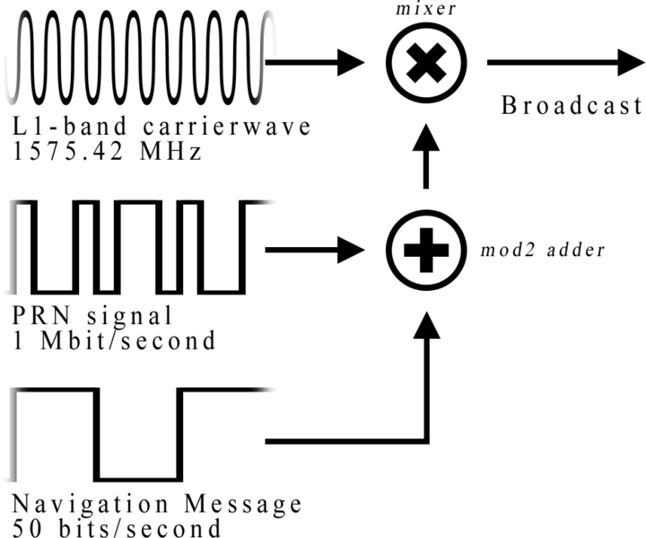
The Global Positioning System (GPS) Modulation Scheme
The GPS employs quadrature Binary Phase Shift Keying (BPSK) modulation at two frequencies (CDMA)
L1 = 1,575.42 MHz
λ1 = 19 cm
L2 = 1,227.6 MHz
λ1 = 24 cm
Two main PRN codes
C/A: Course acquisition
10-bit 1 MHz
P: Precise
40 bit 10 MHz
Encrypted P(Y) code

Slide 12
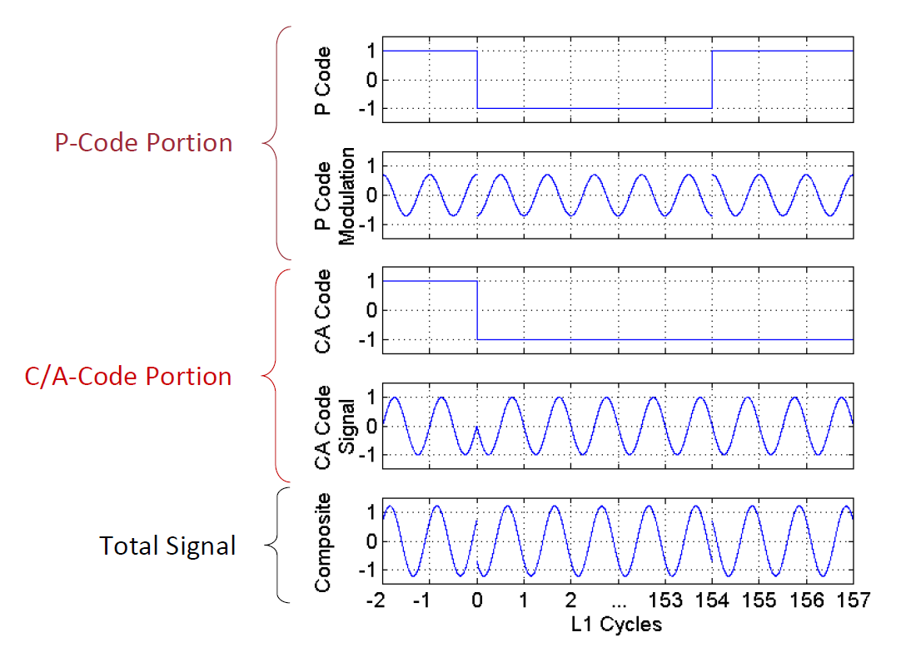
The Global Positioning System (GPS) Modulation Scheme
Quadrature BPSK modulation
Ref: JNC 2010 GPS 101 Short Course by Jacob Campbell

Slide 13
The Global Positioning System (GPS) Signal Processing
Code and Carrier Phase Processing
Code used to determine user’s gross position
Carrier phase difference can be used to gain more accurate position
Timing of signals must be known to within one carrier cycle

Slide 14
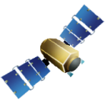
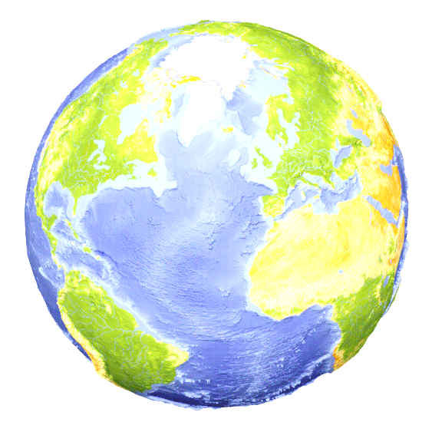
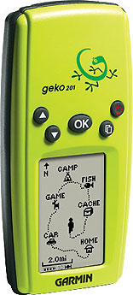
The Global Positioning System (GPS) Pseudorange
All measurements in ECEF coordinates
Sat₁
(x₁,y₁,z₁)
GPS receiver
(x,y,z)
Sat₂
(x₂,y₂,z₂)
ρ₁
ρ₂
ρ₃
Sat₃
(x₃,y₃,z₃)
.
.
.
ρ_{n}
Sat_{n}
(x_{n},y_{n},z_{n})
ρ - pseudorange
r_{e} - Earth’s radius

Slide 15
The Global Positioning System (GPS) Pseudorange
A more realistic model is
Can perturb this model to form
This can be solved via least-squares or Kalman filter

Slide 16
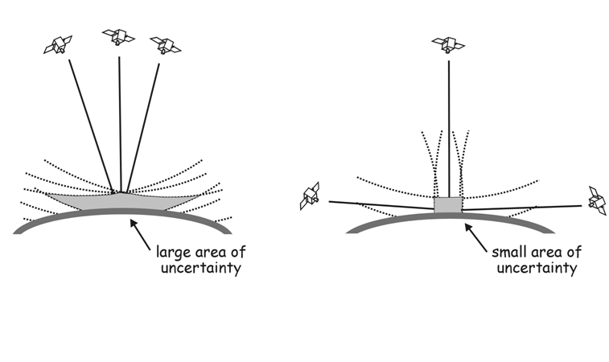
The Global Positioning System (GPS) Sources Of Error - GDOP
Geometry of satellite constellation wrt to receiver
Good GDOP occurs when
Satellites just above the horizon spaced and one satellite directly overhead
Bad GDOP when pseodurange vectors are almost linearly dependent

Slide 17
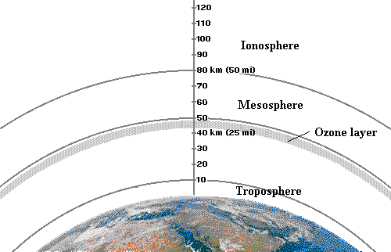
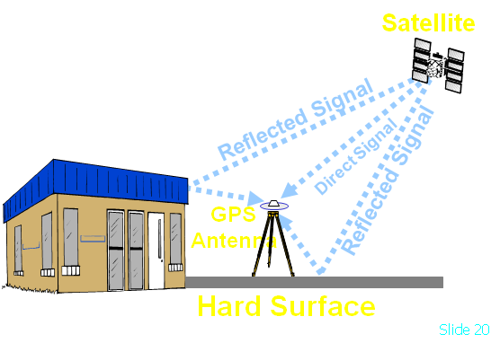
The Global Positioning System (GPS) Other Sources Of Error
Selective Availability
Intentional errors in PRN
Discontinued in 5/1/2000
Atmospheric Effects
Ionospheric
Tropospheric
Multipath
Ephemeris Error
(satellite position data)
Satellite Clock Error
Receiver Clock Error

Slide 18
The Global Positioning System (GPS) Error Mitigation Techniques
Carriers at L1 = 1,575.42 MHz & L2 = 1,227.6 MHz
Ionospheric error is frequency dependent so using two frequencies helps to limit error
Differential GPS
Post-Process user measurements using measured error values
Space Based Augmentation Systems(SBAS)
Examples are U.S. Wide Area Augmentation System (WAAS), European Geostationary Navigational Overlay Service (EGNOS)
SBAS provides atmospheric, ephemeris and satellite clock error correction values in real time

Slide 19
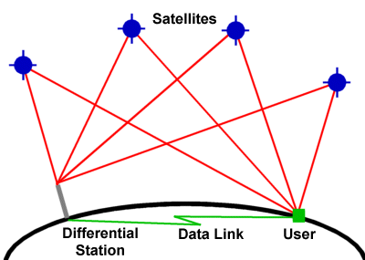
The Global Positioning System (GPS) Error Mitigation Techniques – Differential GPS
Uses a GPS receiver at a fixed, surveyed location to measure error in pseudorange signals from satellites
Pseudorange error for each satellite is subtracted from mobile receiver before calculating position (typically post processed)

Slide 20
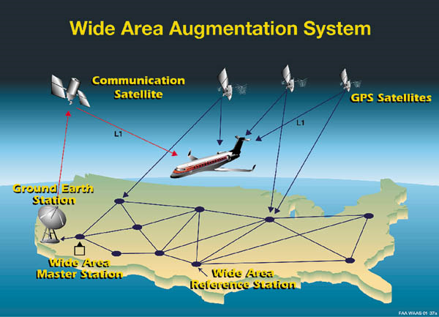
The Global Positioning System (GPS) Error Mitigation Techniques - WAAS/EGNOS
Provide corrections based on user position
Assumes atmospheric error is locally correlated

Slide 21
The Global Positioning System (GPS) Summary of the Sources of Error
Single satellite pseudorange measurement
GPS error summary
SPS: L1 C/A with S/A off
PPS: Dual frequency P/Y code
Ref: Navigation System Design by Eduardo Nebot, Centre of Excellence for Autonomous Systems, The University of Sydney

Slide 22
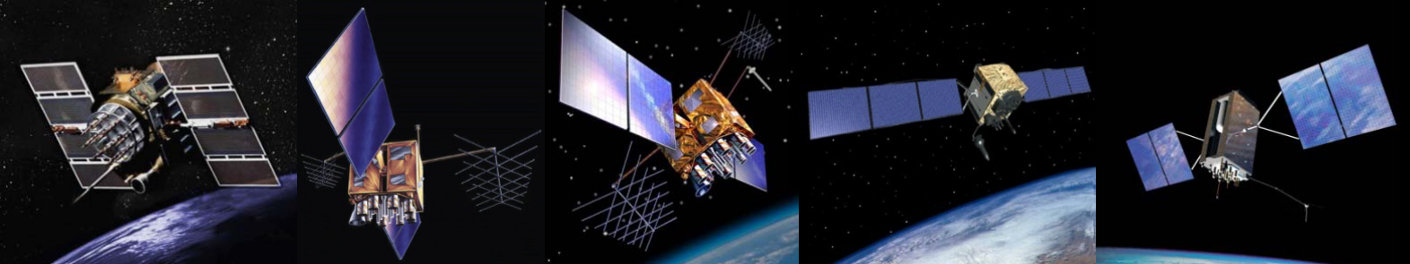
The Global Positioning System (GPS) The Future of GPS
The Future of GPS

Slide 23
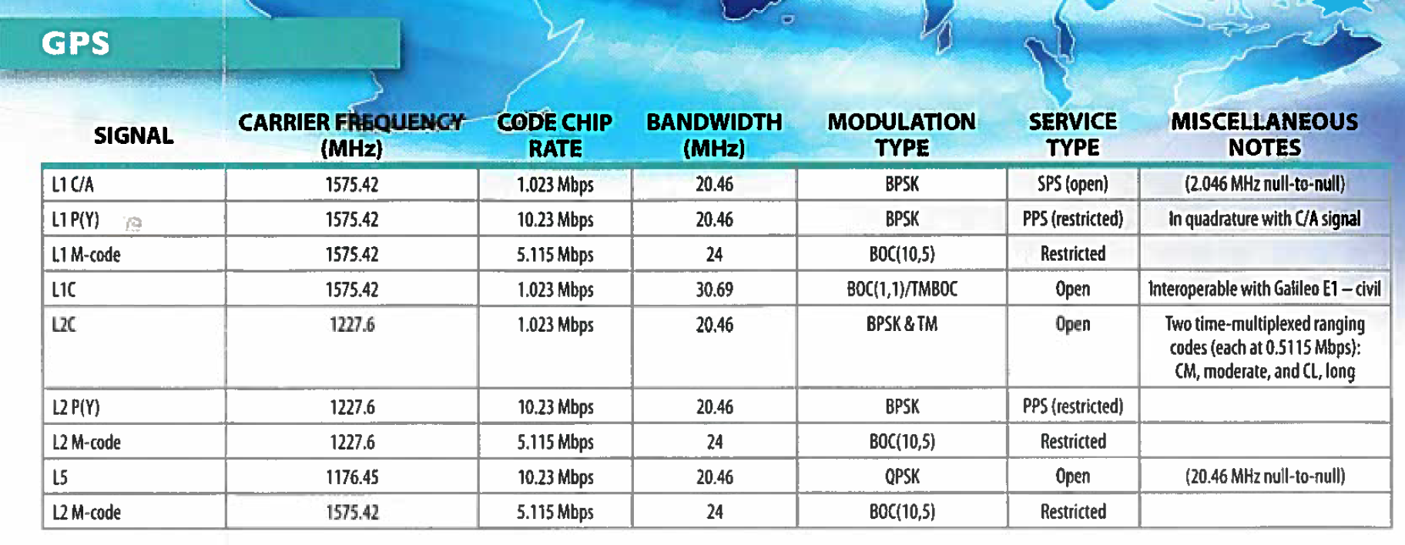
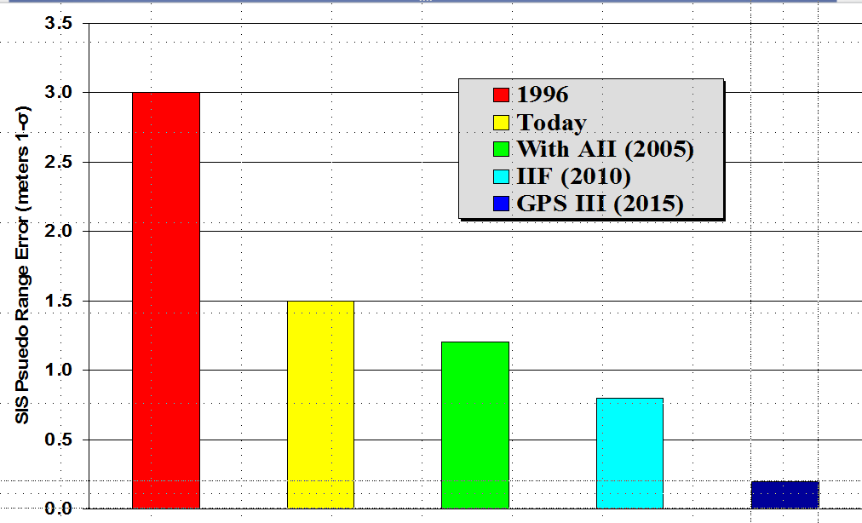
The Global Positioning System (GPS) The Future of GPS

